Slide 1

MBEYA UNIVERSITY OF SCIENCE AND TECHNOLOGY
COLLEGE OF INFORMATION AND COMMUNICATION TECHNOLOGY
5 GENERATION (5G) PRESENTATION
GROUP ASGNMENT

Slide 2
GROUP MEMBERS
NO | NAMES | REG NO
01 | JACKSON B ARONE | 21100934340015
02 | RAMADHAN S MAYUYA | 21100934340016
03 | GROLY F LALISA | 21100934340017
04 | EDWIN C GERALD | 21100934340020
05 | RENATUS RUKANGA | 21100934340023
06 | ENOCK LUBINZA | 21100934340032

Slide 3
INTRODUCTION
5G stands for fifth generation advancement communication technology. It require high frequency range of sub 6 GHz and millimeter waves.
The millimeter wave (10mm to 1mm) covering a frequency range 30GHz to 300GHz, and enabling a 20Mbps data rate.
The millimeter wave band is the most effective solution to the recent surge in wireless Internet usage. These specification are capable of providing wireless word wide web (WWWW)applications.
The WWWW allows a highly flexible network (flexible channel bandwidth between 5 and 20 MHz, optimally up to 40 MHz, and dynamic ad-hoc wireless network (DAWN)
5G is not about changing the existing technologies but to enhance and support them with new technologies that require very high-speed data.

Slide 4
TECHNOLOGIES INVESTIGATED IN 5G
Millimeter wave
It has a frequency range of 30 to 325 GHZ and the wavelength is from 1 to 10 millimeters hence the name.
The shorter the wavelength, the shorter the transmission range. This can be overcome by using high sensitivity receiver, high transmit power and high antenna gain.

Slide 5
TECHNOLOGIES CONT ………
COGNITIVE RADIO
This is a form of wireless communication in which a transceiver can intelligently detect which communication channels are in use and which are not and instantly move into vacant channels while avoiding occupied ones.

Slide 6
TECHNOLOGIES CONT……
Visible light communication
This is a data communication medium which uses visible light between 400 and 800 THZ (780-375 nm).
Also, VLC is a subset of optical wireless communication technologies.

Slide 7
TECHNOLOGIES CONT…..
MASIVE MIMO
Massive MIMO use a very large number of service antennas (eg. hundred or thousand) that are operated fully coherently and adaptively.
The more antennas the transmitter/receiver is equipped with the more the possible signal paths and better the performance in term of data rate and link reliability.
Work on the principle of Time Division Duplexing

Slide 8
FEATURES OF 5G
Speed: Up to 20 Gbps peak data rates.
Latency: As low 1 millisecond.
Capacity: Support 1 million devices per square kilometer.
Energy efficiency: Improve power usage for massive IoT.

Slide 9
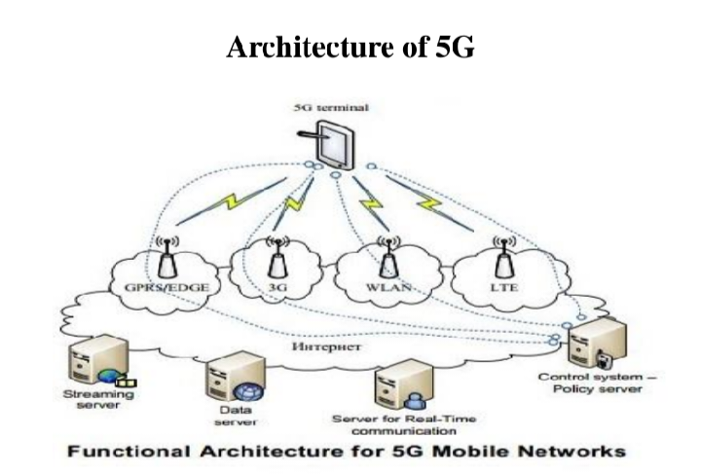
5G NETWORK ARCHITECTURE

Slide 10
ADVANTAGES OF 5G
Data Bandwidth of 1Gbps or higher.
Dynamic information access.
Finest Quality of service
Support interactive multimedia, voice, streaming video, Internet and other broadband services.

Slide 11
DISADVANTAGES OF 5G
Higher frequencies could be blocked by buildings and they lose intensity over long distance.
The speed of this technology is claiming seem difficult to achieve (in future, it might be) because of the incompetent technological support in most parts of the world.

Slide 12
APPLICATIONS
Industrial automation.
In hospitals
Autonomous vehicles.
In smart TVs that need a very high amount of data.

Slide 13
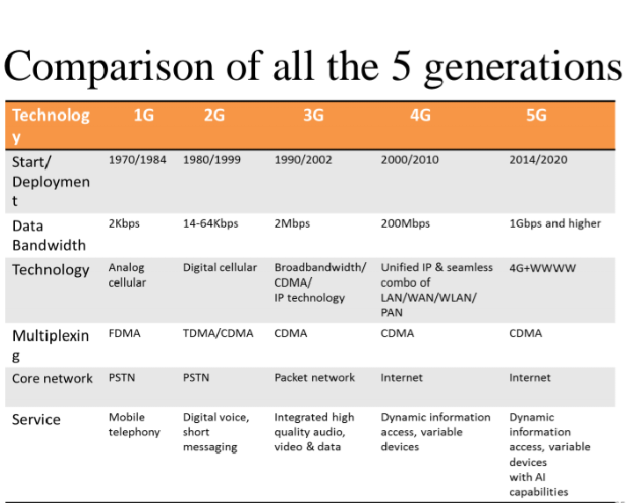
COMPARISON OF ALL 5 GENERATIONS

Slide 14
REFERENCES
https:/electronicsforu.ccomtechnology.trends/introduction-5g-technology
www.google.com
https://www.slideshare.net/OECLIBOdishaElectron/5g-technologyppt
https://www.slideshare.net/danielgeorge17/5g-ppt-new-31950466

